Slide 1
Files: Text Files
Various functions for reading, writing and accessing the information from directories.
These file functions are important because they are used for reading the input and storing the output.
Open()
Close()
Read()
Write()
Rename()
Remove()

Slide 2
The open Function
Before you can read or write a file, you have to open it using Python's built-in open() function.
This function creates a file object, which would be utilized to call other support methods associated with it
Syntax
file object = open(file_name [, access_mode][, buffering])

Slide 3
Here are parameter details:
file_name: The file_name argument is a string value that contains the name of the file that you want to access.
access_mode: The access_mode determines the mode in which the file has to be opened, i.e., read, write, append, etc. This is optional parameter and the default file access mode is read (r).
buffering: If the buffering value is set to 0, no buffering takes place. If the buffering value is 1, line buffering is performed while accessing a file. If you specify the buffering value as an integer greater than 1, then buffering action is performed with the indicated buffer size. If negative, the buffer size is the system default(default behavior).

Slide 4
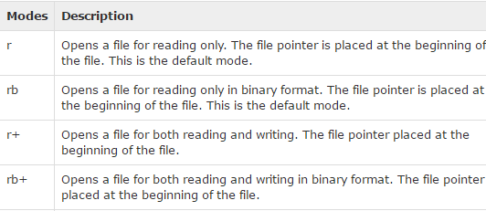
Here is a list of the different modes of opening a file −

Slide 5
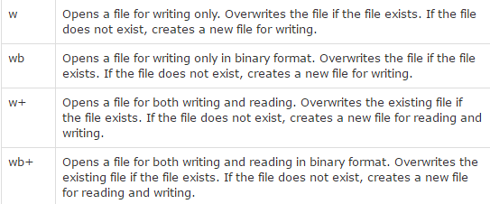

Slide 6
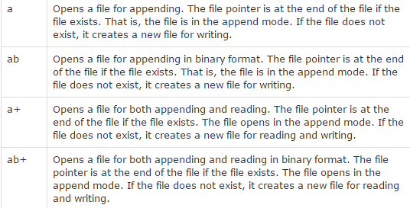

Slide 7
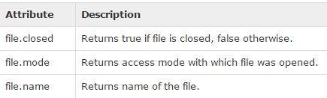
The File Object Attributes
Once a file is opened and you have one file object, you can get various information related to that file.
Here is a list of all attributes related to file object:

Slide 8
fo = open("foo.txt", "wb")
print ("Name of the file: ", fo.name )
print ("Closed or not : ", fo.closed )
print ("Opening mode : ", fo.mode)

Slide 9
This produces the following result −(output)
Name of the file: foo.txt
Closed or not : False
Opening mode : wb

Slide 10
The close() Method
The close() method of a file object flushes any unwritten information and closes the file object, after which no more writing can be done.
Python automatically closes a file when the reference object of a file is reassigned to another file. It is a good practice to use the close() method to close a file.

Slide 11
Syntax
fileObject.close()
# Open a file
fo = open("foo.txt", "wb")
print ("Name of the file: ", fo.name)
# Close opend file
fo.close()

Slide 12
This produces the following result −
Name of the file: foo.txt

Slide 13
The write() Method
The write() method writes any string to an open file. It is important to note that Python strings can have binary data and not just text.
The write() method does not add a newline character ('\n') to the end of the string −
Syntax
fileObject.write(string)

Slide 14
fo = open("foo.txt", "w")
fo.write( "Python is a great language.\nYeah its great!!\n")
# Close opend file
fo.close()

Slide 15
Write with binary mode
fo = open("foo.txt", "wb")
plaintext = "Python is a great language.Yeah its great!!\n"
fo.write(plaintext.encode('utf-8'))
# Close opend file
fo.close()

Slide 16
The above method would create foo.txt file and would write given content in that file and finally it would close that file. If you would open this file, it would have following content.
Python is a great language.
Yeah its great!!

Slide 17
The read() Method
The read() method reads a string from an open file. It is important to note that Python strings can have binary data apart from text data.
Syntax
fileObject.read([count]);

Slide 18
# Open a file
fo = open("foo.txt", "r+")
str = fo.read(10);
print ("Read String is : ", str)
# Close opend file
fo.close()

Slide 19
This produces the following result −
Read String is : Python is

Slide 20
The rename() Method
The rename() method takes two arguments, the current filename and the new filename.
Syntax
os.rename(current_file_name, new_file_name)
Example
import os
# Rename a file from foo.txt to test2.txt
os.rename( “foo.txt", "test2.txt" )

Slide 21
The remove() Method
You can use the remove() method to delete files by supplying the name of the file to be deleted as the argument.
Syntax
os.remove(file_name)
Example
import os
# Delete file test2.txt
os.remove("test2.txt")

Slide 22
Directories
The mkdir() Method
You can use the mkdir() method of the os module to create directories in the current directory.
Syntax
os.mkdir("newdir")
Example
import os
# Create a directory "test"
os.mkdir("test")

Slide 23
The chdir() Method
You can use the chdir() method to change the current directory.
Syntax
os.chdir("newdir")
Example
import os
# Changing a directory to "/home/newdir"
os.chdir("/home/newdir")

Slide 24
Creating new directory by changing the directory
import os
# Changing a directory to "/home/newdir"
os.chdir("test")
os.mkdir("test")

Slide 25
The getcwd() Method
The getcwd() method displays the current working directory.
Syntax
os.getcwd()
Example
import os
# This would give location of the current directory
Print(os.getcwd())

Slide 26
The rmdir() Method
The rmdir() method deletes the directory, which is passed as an argument in the method.
Before removing a directory, all the contents in it should be removed.
It is required to give fully qualified name of the directory, otherwise it would search for that directory in the current directory.
Syntax:
os.rmdir('dirname')
Example
import os
os.rmdir( "C:/Python34/test/test" )

Slide 27
File Positions
The tell() method tells you the current position within the file; in other words, the next read or write will occur at that many bytes from the beginning of the file.
The seek(offset[, from]) method changes the current file position. The offset argument indicates the number of bytes to be moved. The from argument specifies the reference position from where the bytes are to be moved.
If from is set to 0, it means use the beginning of the file as the reference position and 1 means use the current position as the reference position and if it is set to 2 then the end of the file would be taken as the reference position.

Slide 28
# Open a file
fo = open("foo.txt", "r+")
str = fo.read(10);
print ("Read String is : ", str)
# Check current position
position = fo.tell();
print ("Current file position : ", position)
# Reposition pointer at the beginning once again
position = fo.seek(0, 0);
str = fo.read(10);
print ("Again read String is : ", str)
# Close opend file
fo.close()

Slide 29
Read String is : Python is
Current file position : 10
Again read String is : Python is

Slide 30
#To use non zero values in seek we have to open file in binary format
# Open a file
fo = open("foo.txt", "rb+")
str = fo.read(10);
print ("Read String is : ", str)
# Check current position
position = fo.tell();
print ("Current file position : ", position)
# Reposition pointer at the beginning once again
fo.seek(-10,2);
str = fo.read(10);
print ("Again read String is : ", str)
# Close opend file
fo.close()

Slide 31
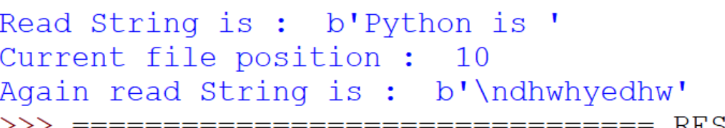

Slide 32
Iterables
List, strings, tuples, files etc
Iterable is capable of creating iterators.
To be an iterable you need to be able to create your own iterator
Iterator is an object created from calling the __iter__() method.
Iterator has the ability to go through each element in an iterable one by one.
They utilize the __next__() method.
Eg:
list=[1,2,3,4]
for i in list:
print i

Slide 33
For is calling the __iter__() function on list and creating a iterator and next it will call the next() method until the list is exhausted

Slide 34
ITERATOR
Iterators are objects that can be iterated upon. Iterators are everywhere in Python. They are elegantly implemented within for loops, comprehensions, generators etc. but hidden in plain sight.
Iterator in Python is simply an object that can be iterated upon. An object which will return data, one element at a time.
Technically speaking, Python iterator object must implement two special methods, __iter__() and __next__(), collectively called the iterator protocol.
An object is called iterable if we can get an iterator from it. Most of built-in containers in Python like: list, tuple, string etc. are iterables.
The iter() function (which in turn calls the __iter__() method) returns an iterator from them.

Slide 35
WE USE THE NEXT() FUNCTION TO MANUALLY ITERATE THROUGH ALL THE ITEMS OF AN ITERATOR. WHEN WE REACH THE END AND THERE IS NO MORE DATA TO BE RETURNED, IT WILL RAISE STOPITERATION.
>>> my_list = [1,2,3,4]
>>> my_iter=iter(my_list)
>>> print(next(my_iter))
1
>>> print(next(my_iter))
2
>>> print(next(my_iter))
3
>>> print(next(my_iter))
4
>>> print(next(my_iter))
Traceback (most recent call last):
File "<pyshell#6>", line 1, in <module>
print(next(my_iter))
StopIteration

